Slide 1

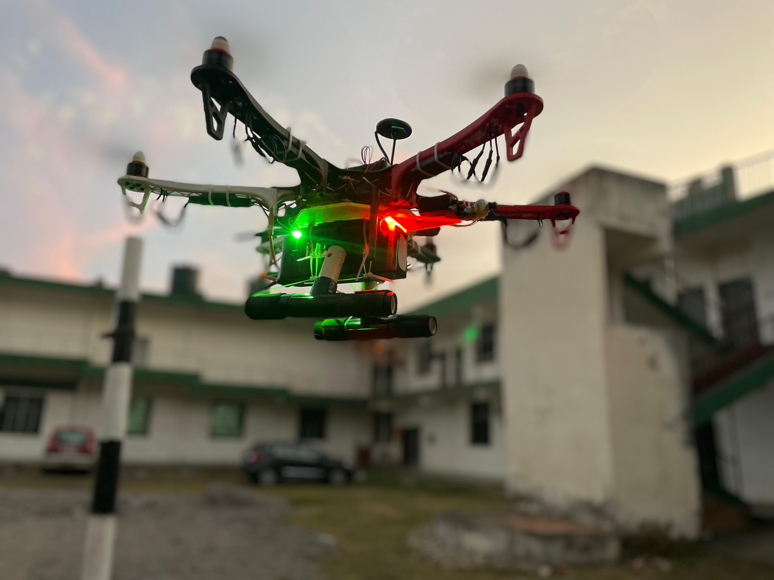

RIMS Cybernetics Incubation Centre
100% Subsidiary of RIMS
Rourkela Institute of Management Studies
exploidrone
A Cyberdrone Project
Project By:
Arnab Hembram
Saimon Soren
Maheswar Sahoo
Guided By:
Prof. Bibhudendu Panda
Rohit Gorai

Slide 2
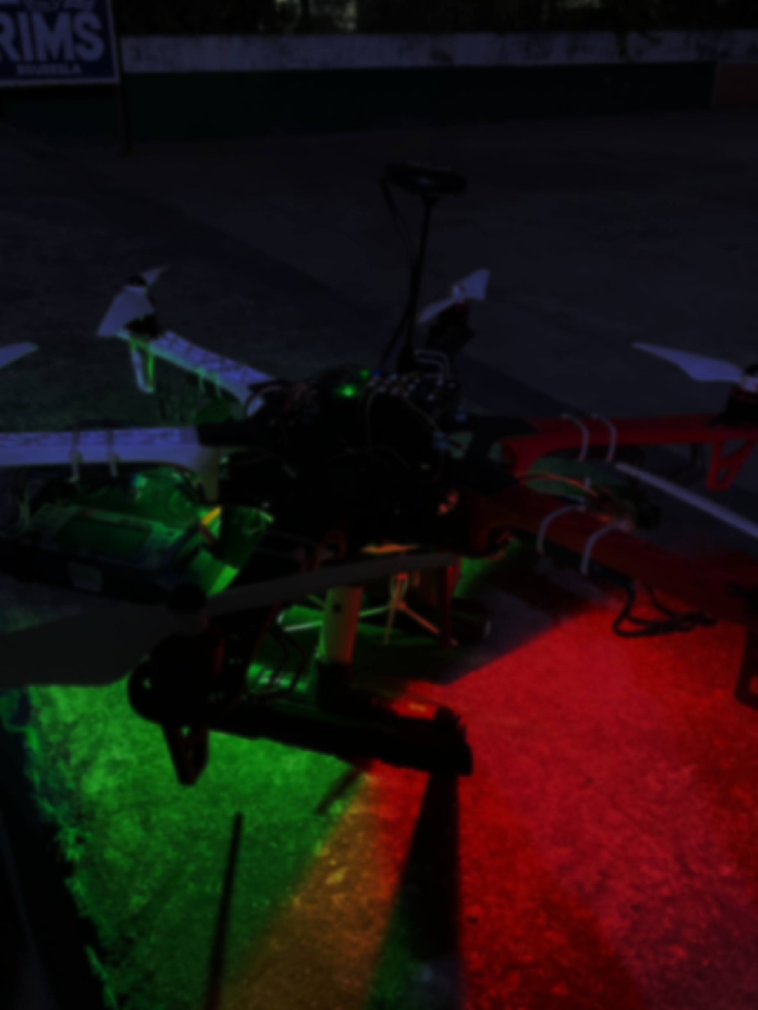
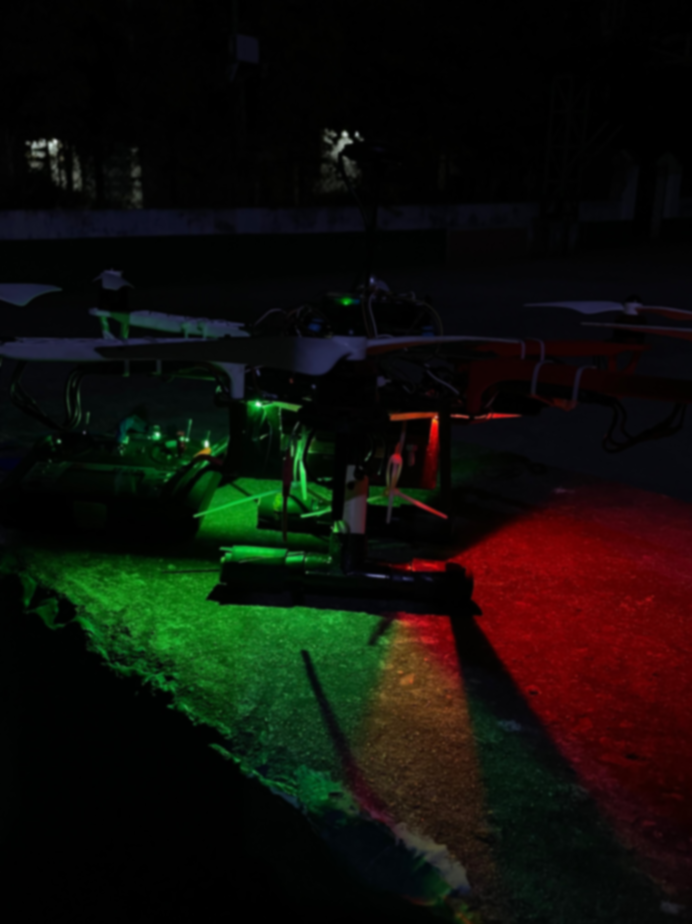
Vision
The vision of the drone is to provide unmanned surveillance in the under privileged area where monitoring is not possible due to harsh conditions of the environment.
The scope is-:
To embed Real time videos and its processing in drone application.
To provide security and privacy consideration in drone communication.

Slide 3
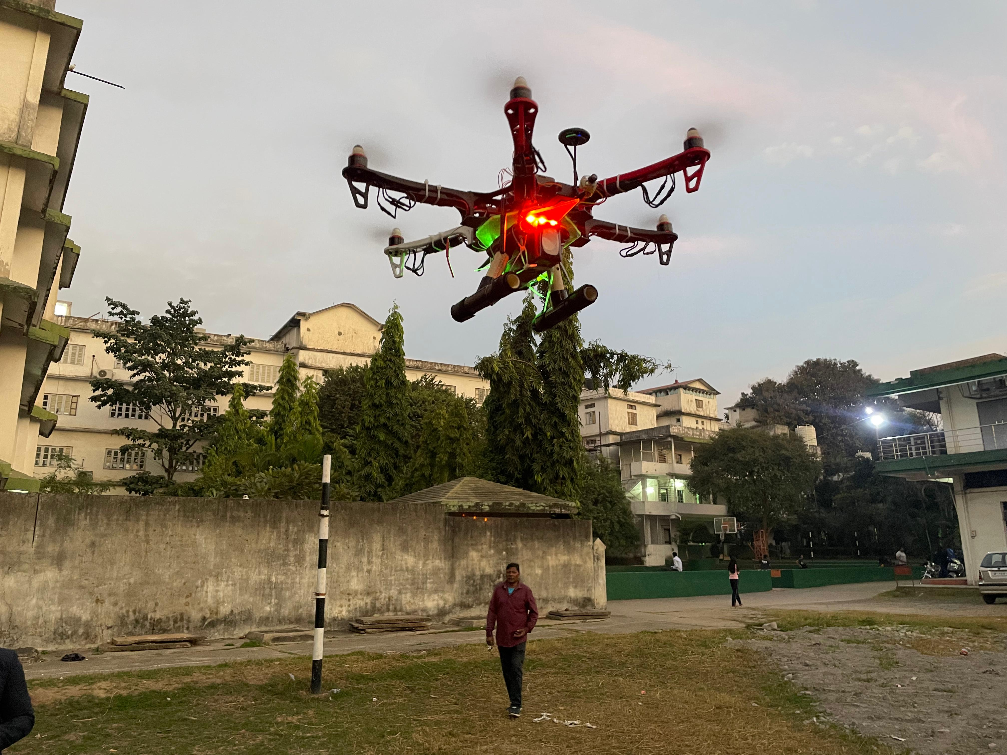
applications of drone.
Can hold Altitude over an area
Object Detection Camera
Signal of drone is encrypted.
Medical Emergency

Slide 4
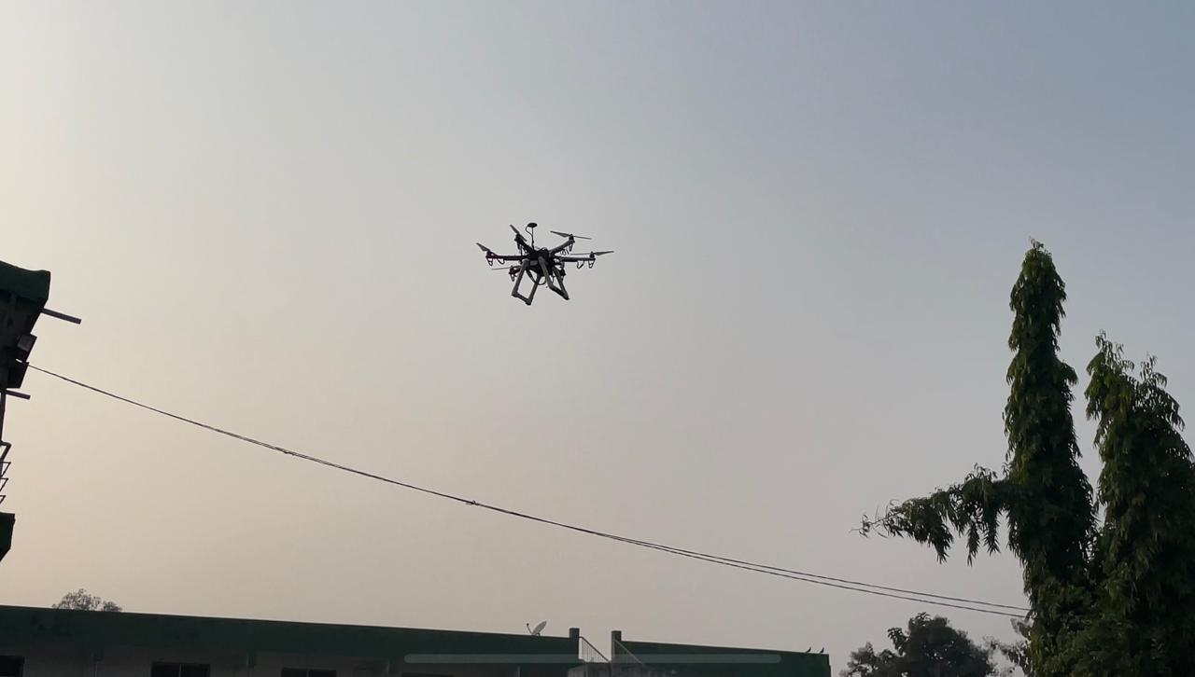
Feature
Object detection
Encrypted Drone Signals.
Altitude hold
Satellite Connectivity via GPS

Slide 5
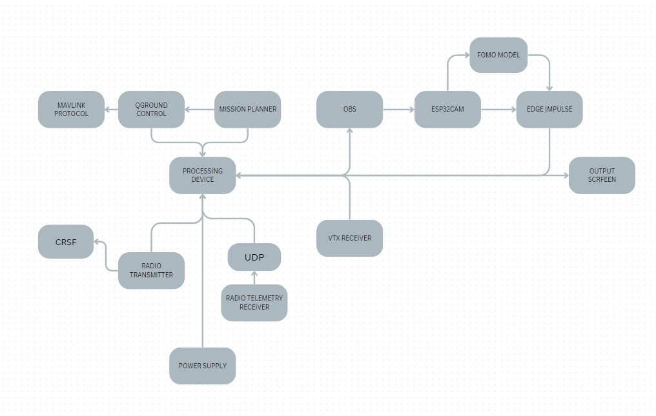
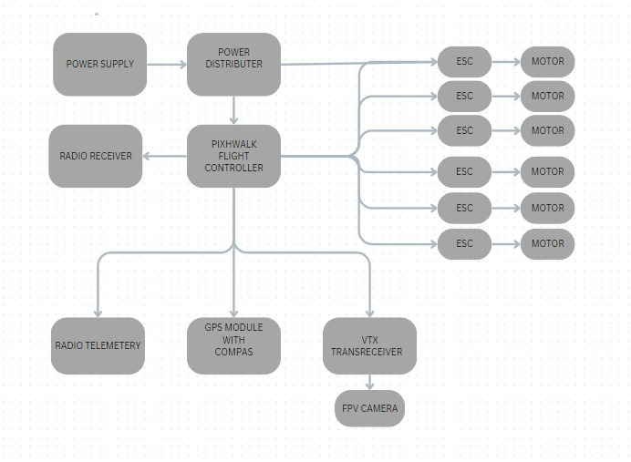
Drone
Ground control unit

Slide 6
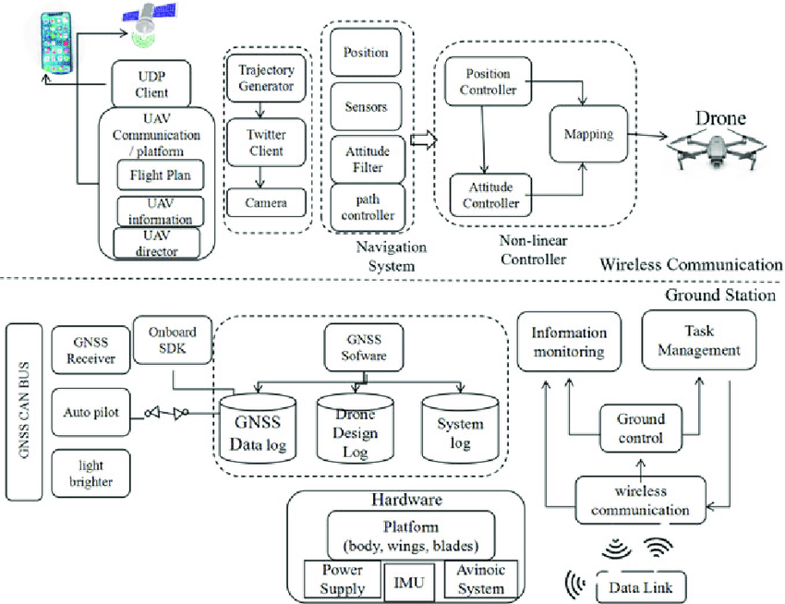
Encrypted Drone Signals.
This drone is programmed with AES-256bit encryption security, nearly impossible to hijack the signals.
This drone is specialized with 14 round By using AES-256 encryption, drones can achieve a high level of data security, making them suitable for sensitive applications such as military, industrial, and commercial use cases where data protection is paramount.

Slide 7
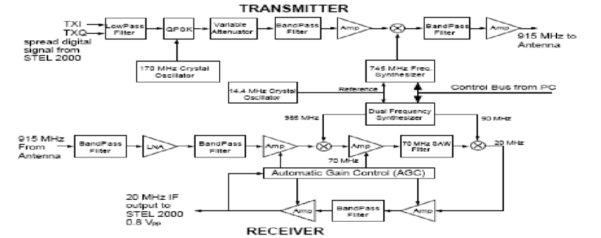
RF signal Monitor of every device and RF signal interception.
A signal monitoring device will be mounted with the drone and the signal will be monitored and stored on-board which will further transmit the signal wirelessly to the on-hand device within an interval of every 5 minutes, for inspection.
Once the packets are captured, Information like malicious signals/ unknown data signals/ encrypted signals/radio/audio signals(walkie talkie) will be stored into the server.
The stored information can be further decrypted or read.

Slide 8
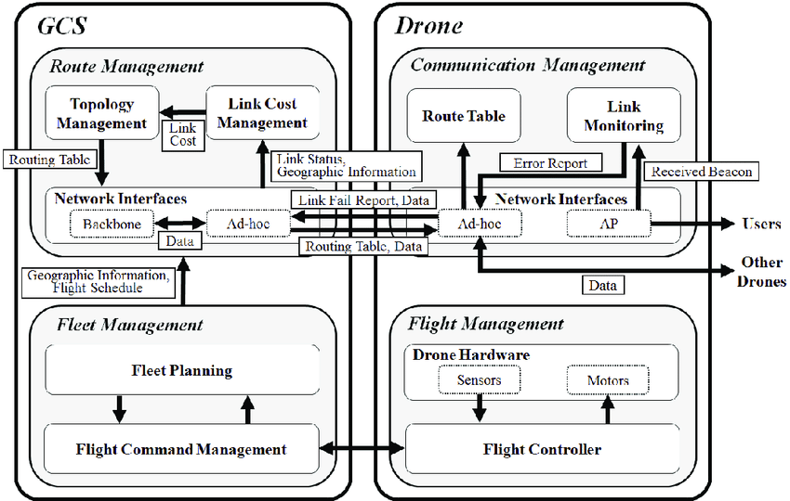
Ground Control Station Software (GCS)
Remote Control of the Drone
Telemetry and Data Monitoring
Mission Planning
Communication with Drone
Safety Features
Live Video Feed
Flight Log and Data Storage
Software Integration

Slide 9
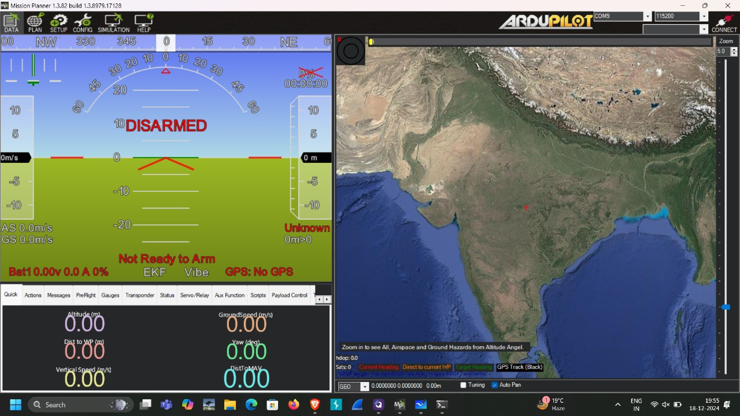

Slide 10
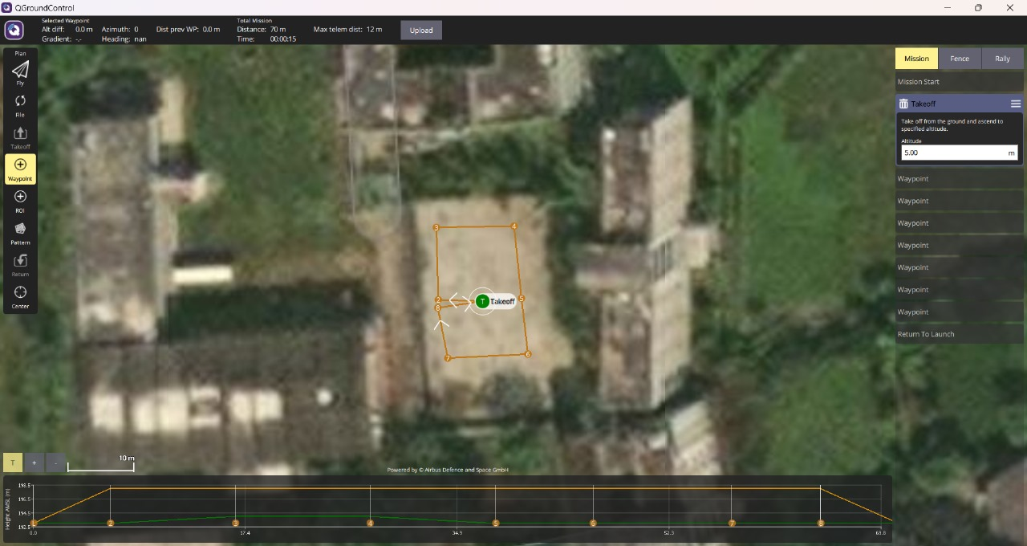
Planned Mission on Ardupilot Mission Planner

Slide 11
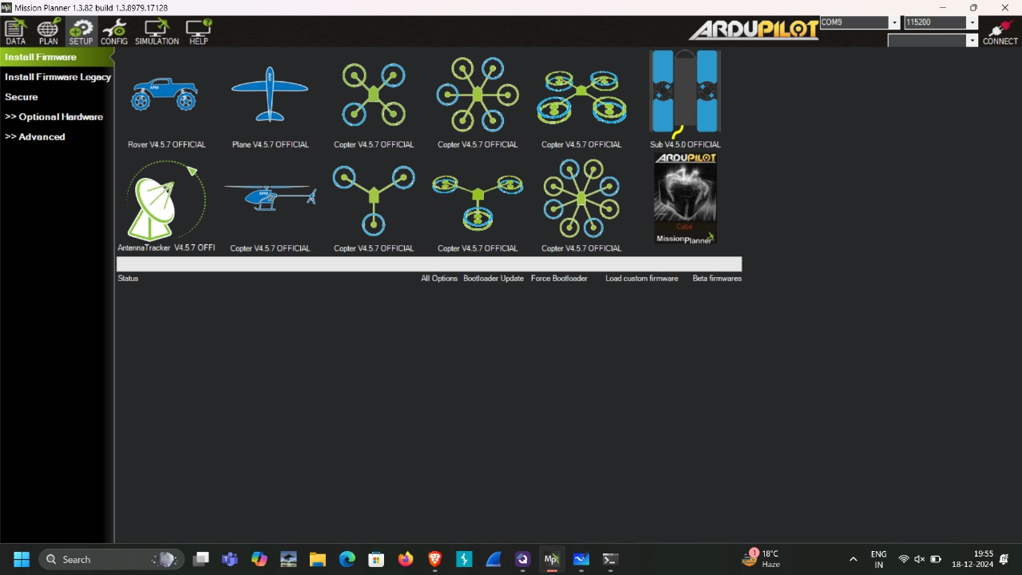

Slide 12
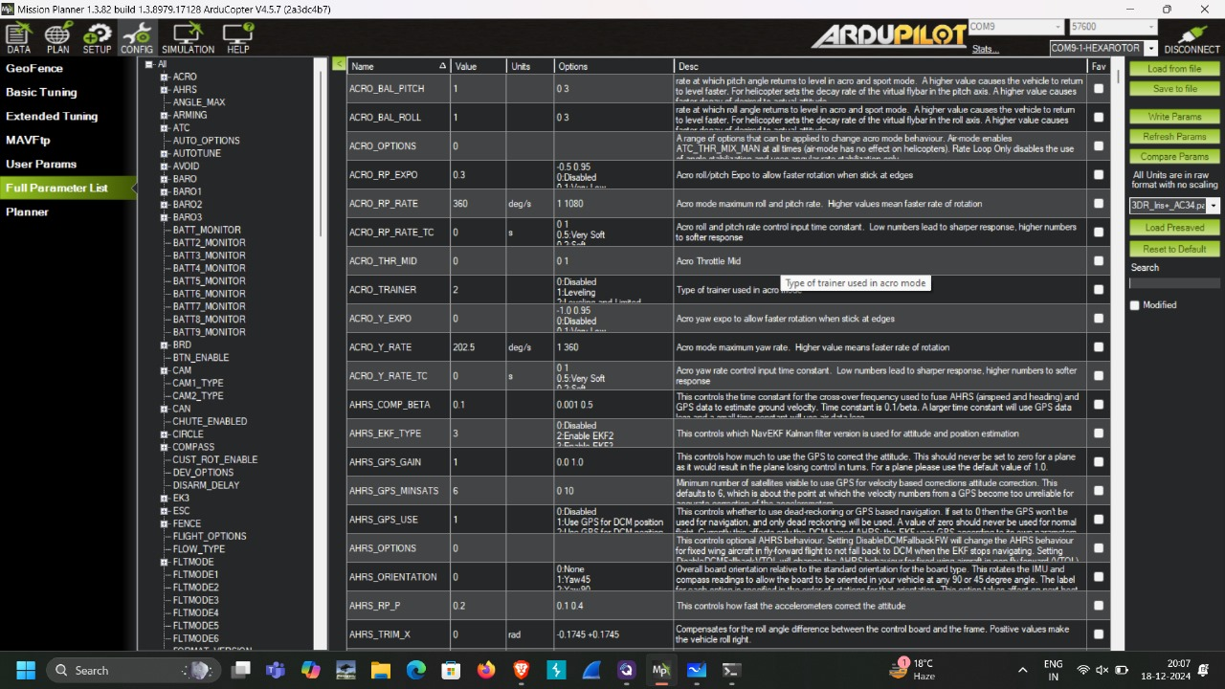

Slide 13
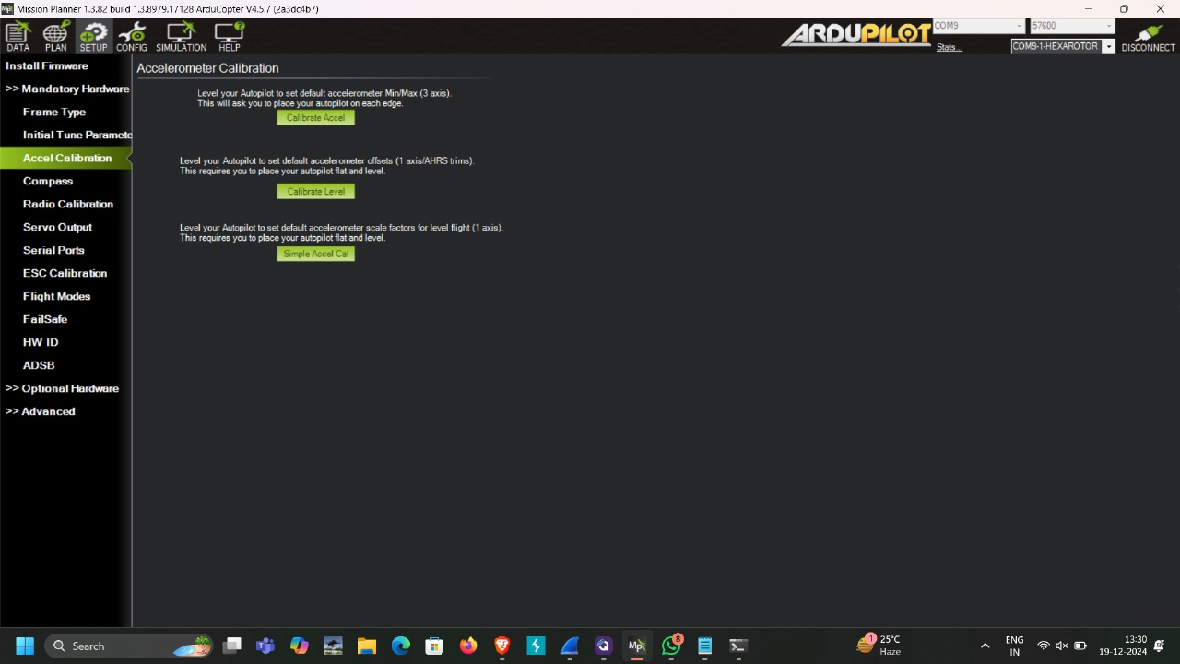

Slide 14
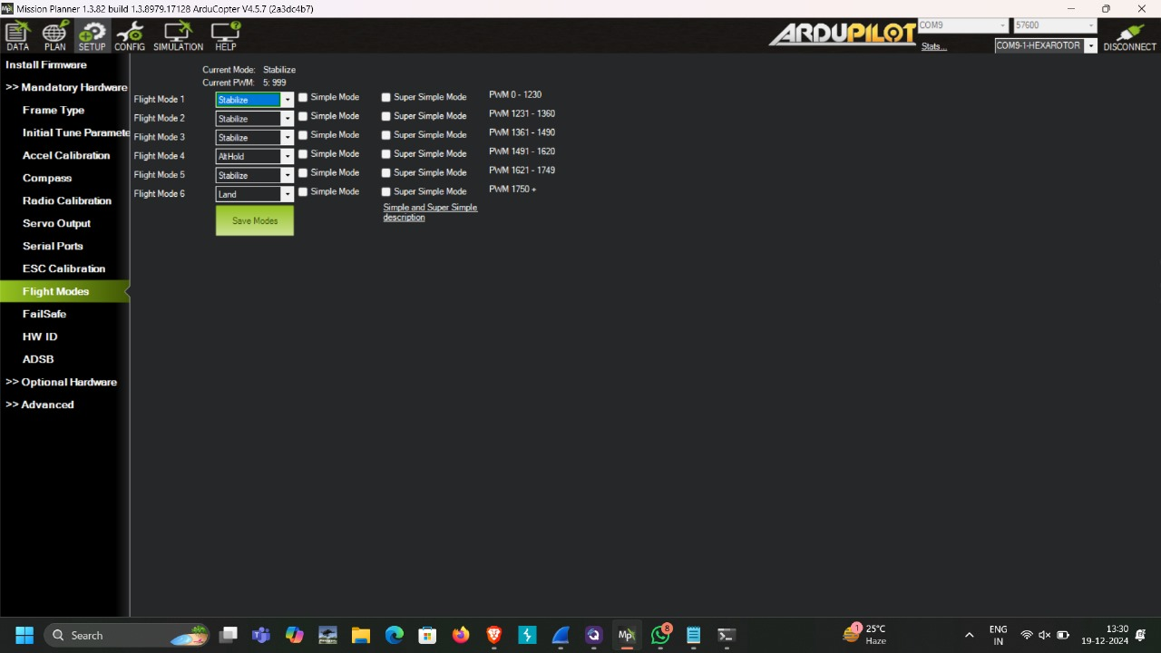

Slide 15
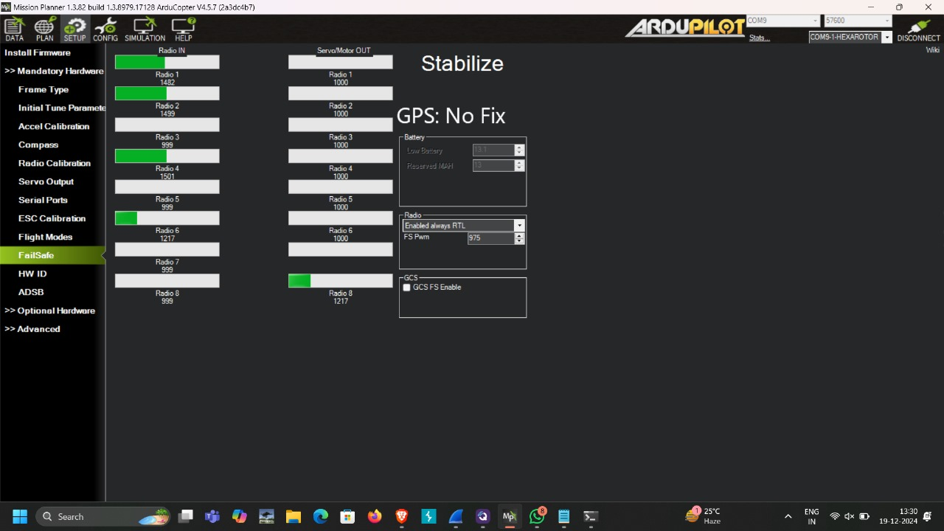

Slide 16
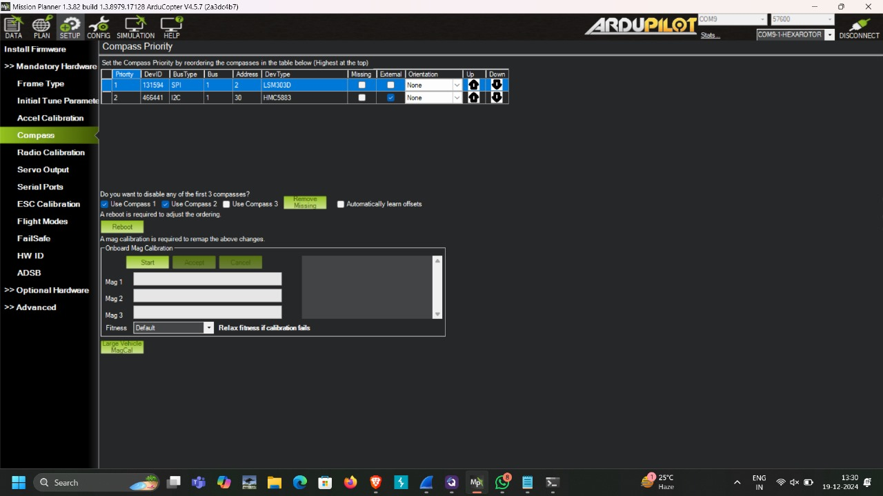

Slide 17
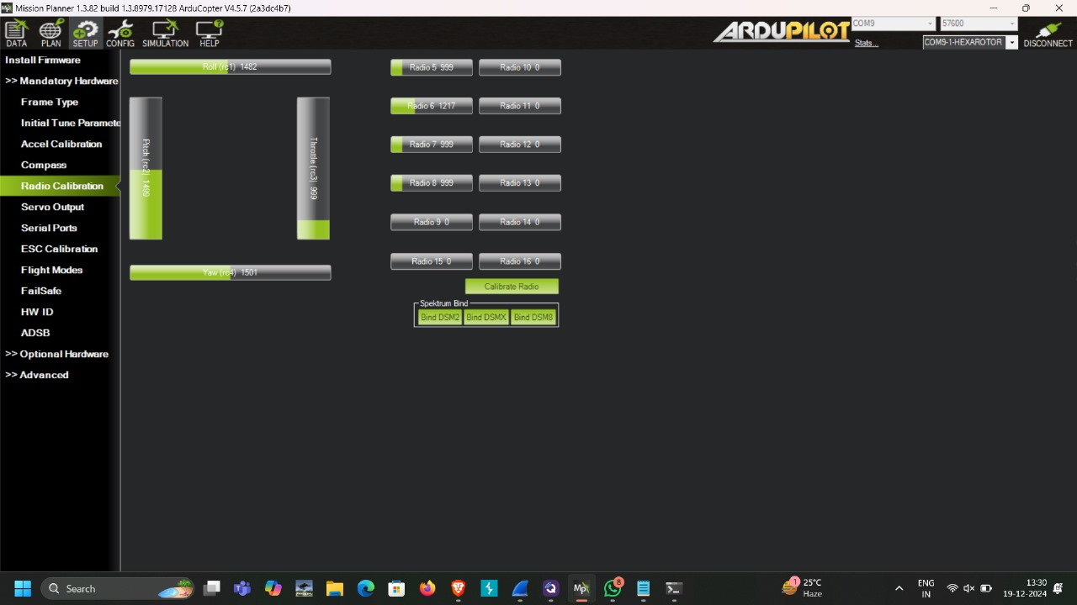

Slide 18
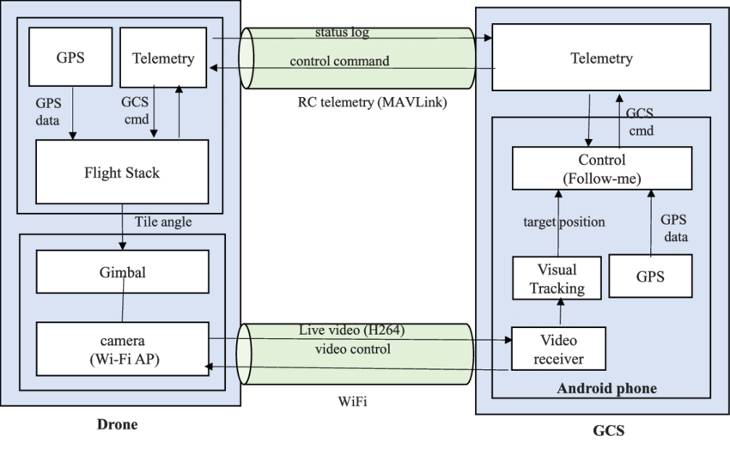
Real time videos and its processing.
Real-time video transmission in drones involves capturing video ,encoding it for efficient transmission and transmitting it wirelessly to a ground station. On the ground ,the video is received, decoded and displayed in real-Time. This enables pilots to see what the drone sees, facilitating navigation and detection, and obstacle avoidance can be applied to enhance the video feed and automate drone operation .

Slide 19
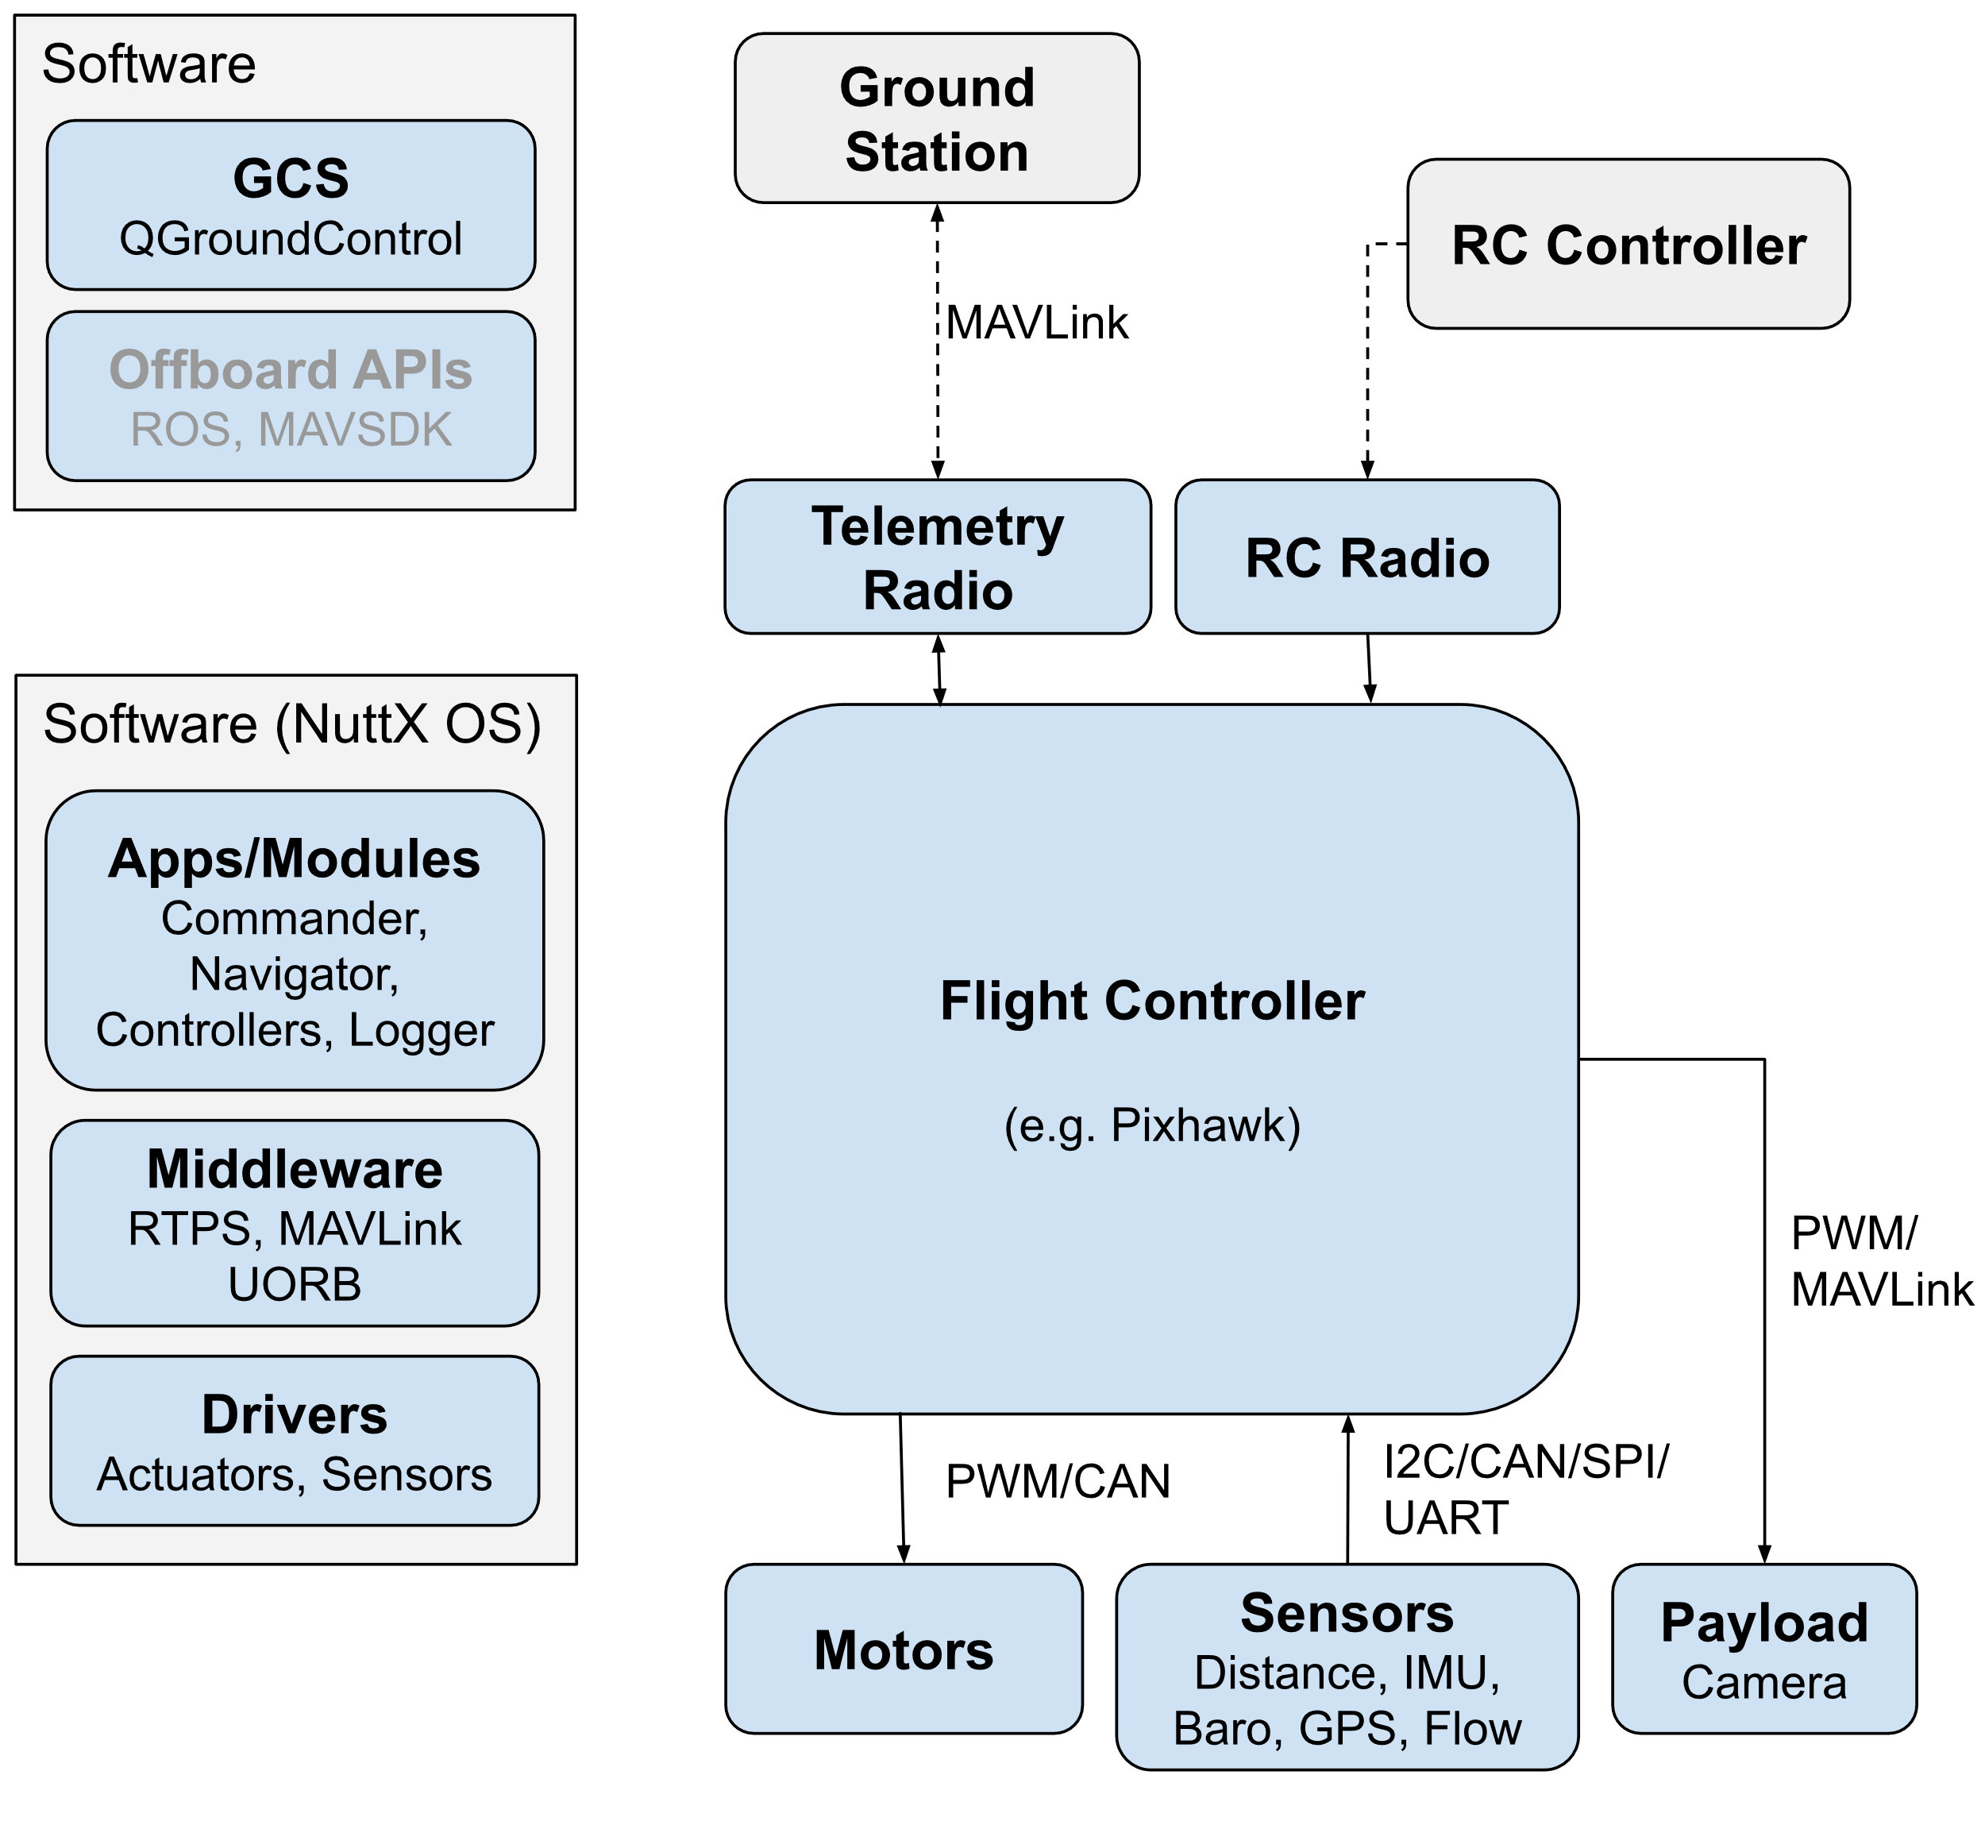
Flight Log Analysis
Flight Data Logging - Drones continuously record various parameters during flight, such as GPS coordinates, altitude, speed, battery levels, sensor data, and flight commands.
Telemetry Data - This includes details like GPS accuracy, temperature, voltage, and communication strength
Error Detection and Troubleshooting - This data helps diagnose problems and take corrective action before future flights.
Flight Path Analysis - Log data also tracks the drone’s flight path, enabling operators to visualize the route taken, the altitude maintained, and any deviations from the planned mission.
Safety and Compliance - Operators need to submit logs to authorities to demonstrate adherence to no-fly zones, altitude limits, or other legal requirements.
Post-Flight Analysis - After a mission, log analysis helps in evaluating the success of the flight.

Slide 20
Basic command and control interfaces
01
Manual Remote Control (Transmitter)
02
Autonomous Control
03
Ground Control Station
04
Desktop App

Slide 21
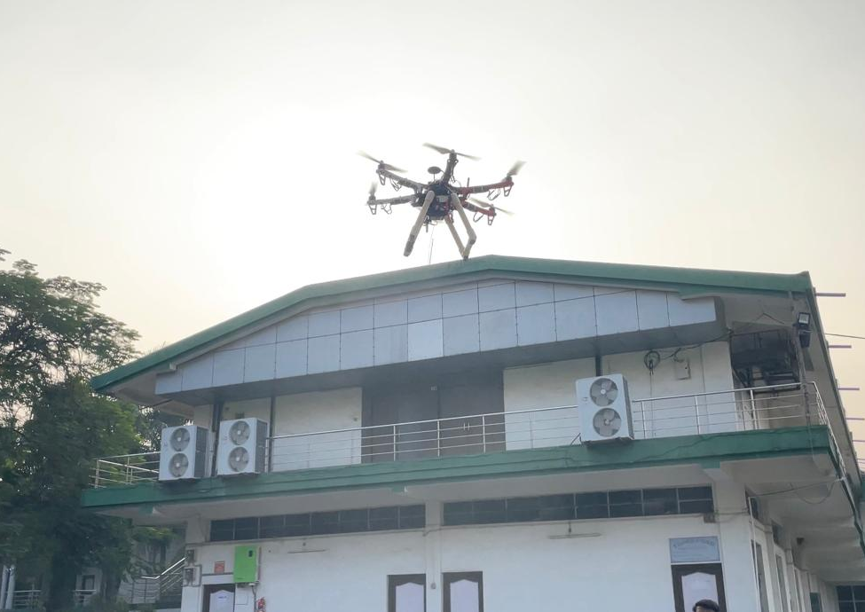
What is UAV systems subsystems and components?
Propulsion Components: Motors & propellers
Airframe Components: Wings & landing gear.
Power Components: Batteries, fuel cells, power distribution boards, electrical wiring.
Flight Control Components: Gyroscopes, accelerometers, flight controllers, servos.
Navigation Components: GPS receivers, accelerometers, altimeters, and compass sensors.
Communication Components: Radio transceivers, antennas, data links, telemetry units, and satellite communication systems.
Payload Components: Cameras, sensors (thermal, infrared, multispectral), radar units, and other mission-specific equipment.
Safety Components: Parachutes, emergency landing systems, and geofencing systems. c

Slide 22
System Conceptualization and Avionics Development
IMU (Inertial Measurement Unit) in Drones-
Components of an IMU:
Accelerometer:
Measures linear acceleration along the x, y, and z axes.
Critical for maintaining stable flight and estimating the drone's velocity.
Gyroscope:
Helps stabilize the drone during turns, gusts of wind, or other dynamic conditions.

Slide 23


CONCLUSION
So, this work has explored the potential of drones in providing unmanned surveillance solutions. By integrating real-time video processing and robust encryption, drones can offer secure and reliable monitoring. The implementation of altitude hold and satellite connectivity enhances the drone's capabilities and operational range. We believe that this technology has the potential for better surveillance and monitoring practices.
So, this work has explored the potential of drones in providing unmanned surveillance solutions. By integrating real-time video processing and robust encryption, drones can offer secure and reliable monitoring. The implementation of altitude hold and satellite connectivity enhances the drone's capabilities and operational range. We believe that this technology has the potential for better surveillance and monitoring practices.

